Slide 1



Analysis of Customer Relational Management for a Bank
By :- Milin Rao Deshmukh

Slide 2
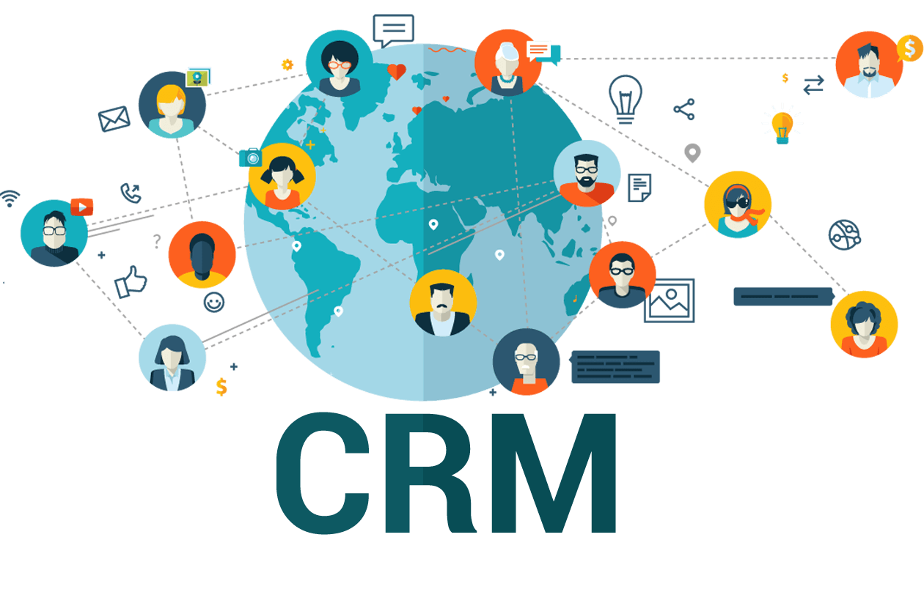
Agenda
In this project, we're diving into CRM and why it’s crucial in banking. We’ll break down customer churn, what drives it, and how we can predict it. We'll explore data, segment customers, and analyze key metrics. Finally, we’ll discuss retention strategies, insights gained, and our recommendations!

Slide 3
What is CRM ?
Customer Relationship Management (CRM) refers to the strategies, practices, and technologies that businesses use to manage and analyze customer interactions and data throughout the customer lifecycle. The primary goal of CRM is to improve customer relationships, increase customer retention, and drive sales growth.
CRM helps businesses:
Build stronger relationships with customers.
Improve customer satisfaction and loyalty.
Enhance business profitability and growth.

Slide 4
Problem Statement
Customer churn, the rate at which customers stop doing business with a bank, is a major concern in the banking industry. High churn rates negatively impact profitability and long-term sustainability. Identifying the key factors that contribute to churn and implementing strategies to reduce attrition is essential for banks to:
Maintain customer loyalty.
Maximize revenue.
Ensure long-term business stability.

Slide 5
Key Data overview
Our dataset contains information about 10,000 banking customers, covering various aspects of their profiles and interactions with the bank.
Demographics: Includes details like Age, Gender, and Geography, helping us understand customer distribution.
Financials: Features like Balance, Salary, and Credit Score give insights into customers' financial status.
Banking Activity: Tracks Number of Products, Credit Card Ownership, and Active Status to analyze engagement levels.
Churn Status: Indicates whether a customer has left the bank or remained active, crucial for understanding churn behavior.
Our dataset is essential for identifying patterns, predicting churn, and implementing strategies to improve customer retention.

Slide 6
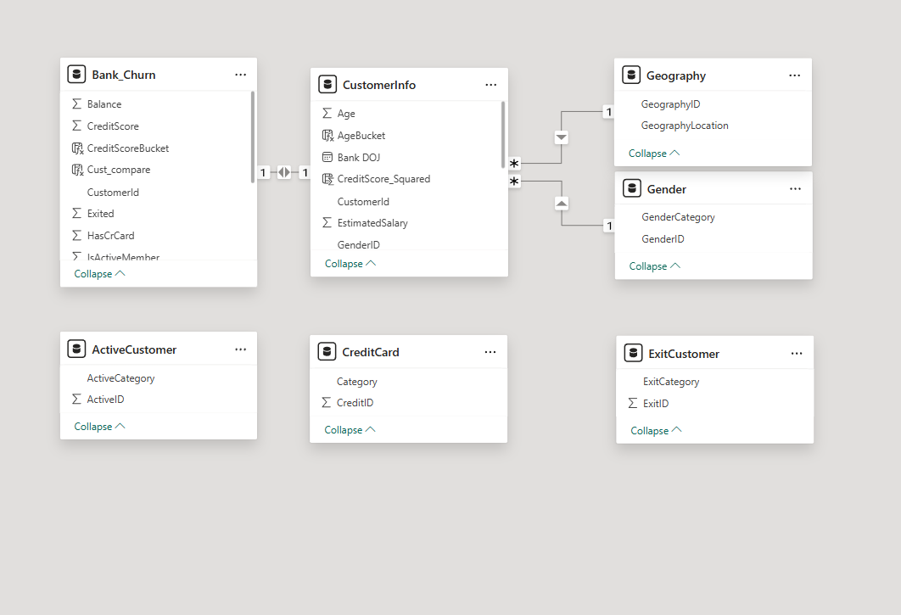
Data Schema

Slide 7
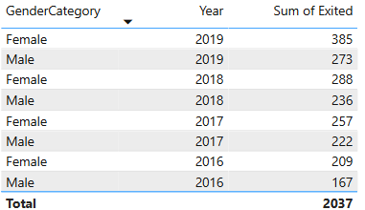
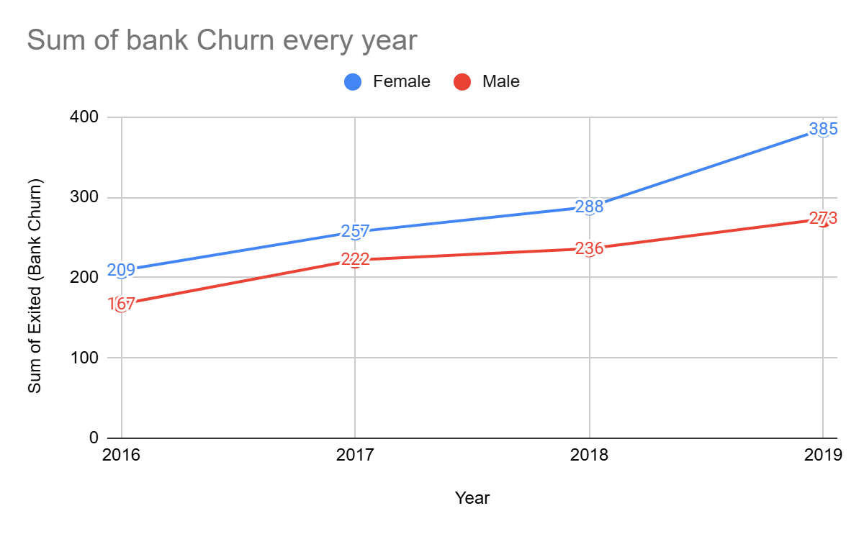
Key factors
Churn Trend by Gender Over the Years
Approach:
We used a double-line chart to compare how many male and female customers left the bank each year.
Insights:
More females exited than males every year.
Churn numbers have increased steadily for both.
2019 had the highest exits for both genders.
Recommendations:
Understand why more females are leaving.
Create gender-specific strategies to improve retention.
Focus on reducing the overall churn trend.

Slide 8
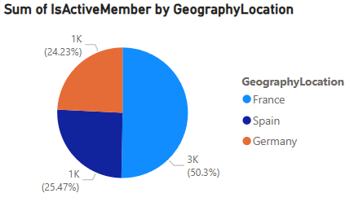
Key factors
Active Customers by Region
Insights:
France has the highest number of active customers (2591).
Spain comes next with 1312 active members.
Germany has the least active users (1248).

Slide 9
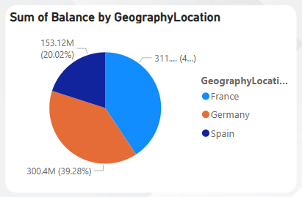
Key factors
Total Balance of Customers in Each Region
Insights:
France has the highest total balance (40.7%).
Germany is close behind with 39.28%.
Spain has the lowest balance (20.02%), nearly half of Germany's.

Slide 10
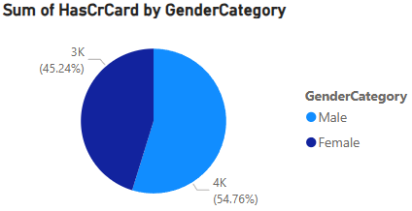
Key factors
Credit Card Ownership by Gender
Insights:
More males (3863) have credit cards than females (3192).
Males make up a slightly larger portion of total cardholders.

Slide 11
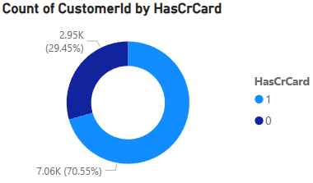
Key factors
Credit Card Ownership Overview
Insights:
70.5% of customers own a credit card.
29.5% of customers do not have a credit card.
Majority of the customer base is engaged with credit card services.

Slide 12
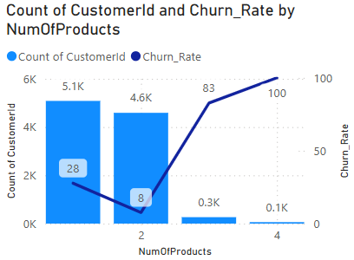
Key factors
Total Customers & Churn Rate vs. Number of Products
Insights:
Customers with 4 products have the highest churn rate (100%).
Most customers have only 1 product, with fewer customers purchasing more.
Churn rate increases as the number of products rises.

Slide 13
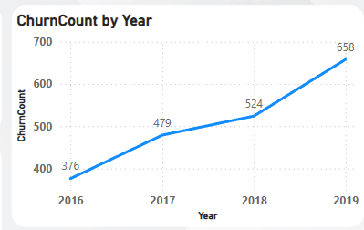
Key factors
Churn Count Analysis
Insights:
Churn steadily increased year over year, with a noticeable jump from 2018 to 2019.
The largest increase occurred in 2019, reaching 658 churned customers, nearly doubling from 376 in 2016.
Overall, the churn count grew consistently, highlighting rising customer loss over four years.

Slide 14
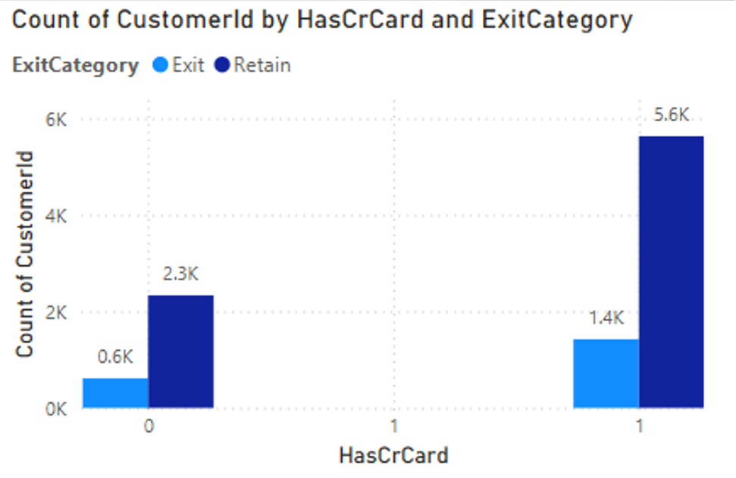
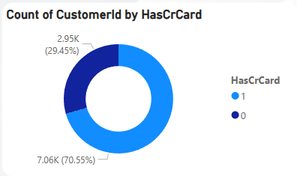
Key factors
Churn Rate Analysis
Insights:
Customers with credit cards are more likely to stay.
Non-cardholders are more likely to leave.
Most customers have credit cards, but those without are at a higher risk of churning.

Slide 15
Recommendations:
To keep our customers happy and reduce churn, here’s what we can do:
Make it personal: Offer services that match customer needs, like customized loan plans or special savings options.
Reward loyalty: Give benefits like cashback, discounts, or reward points to customers who stay with us.
Stay ahead of problems: Identify customers who might leave and reach out to solve their issues before they go.
Offer better deals: Competitive interest rates, exclusive perks, and better financial products can keep customers engaged.
Improve digital services: Make online banking smoother and more user-friendly with better apps and website features.
Listen and adapt: Regularly collect feedback and make changes based on what customers really want.

Slide 16
Conclusion
Understanding Churn – We analyzed customer behavior to find key factors leading to customer attrition.
Data-Driven Insights – Patterns in demographics, transaction history, and account activity helped us identify churn risks.
Effective Strategies – Personalized offers, better customer engagement, and improved service quality can reduce churn.
Positive Impact – Implementing retention strategies led to a decrease in churn rate and improved customer loyalty.
Future Steps – Continuous monitoring, adapting strategies, and leveraging data analytics will help maintain long-term customer relationships.

Slide 17

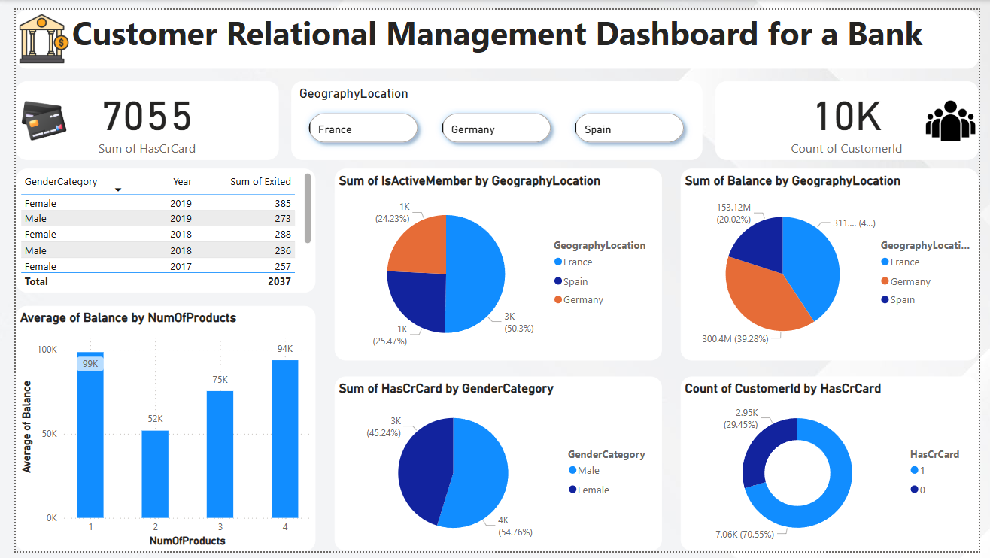
Dashboard 1/3

Slide 18
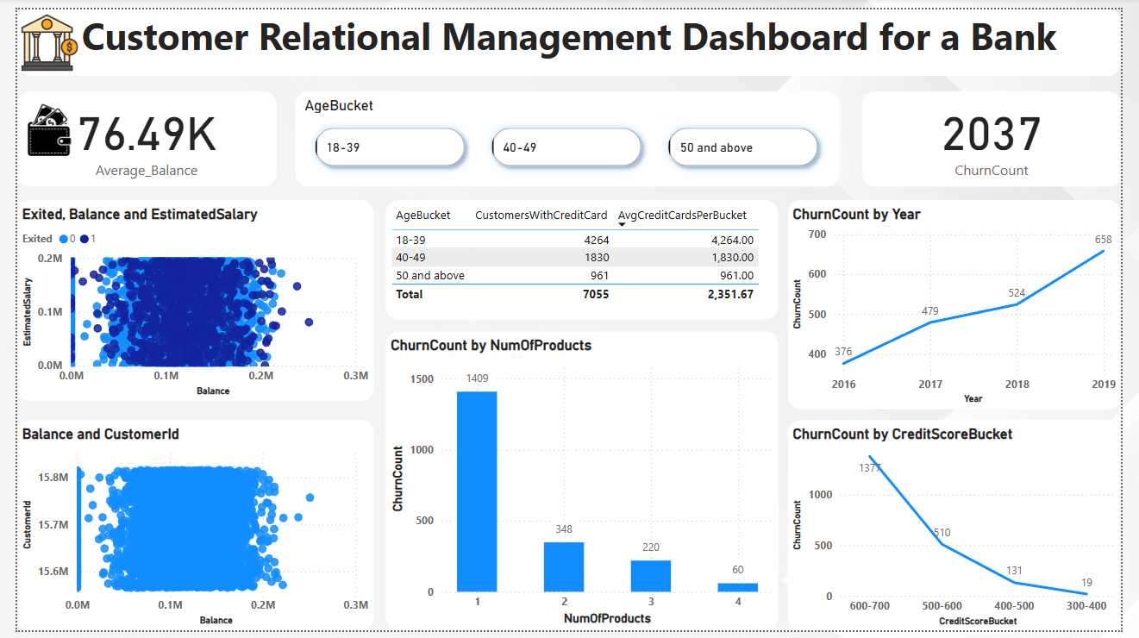
Dashboard 2/3

Slide 19
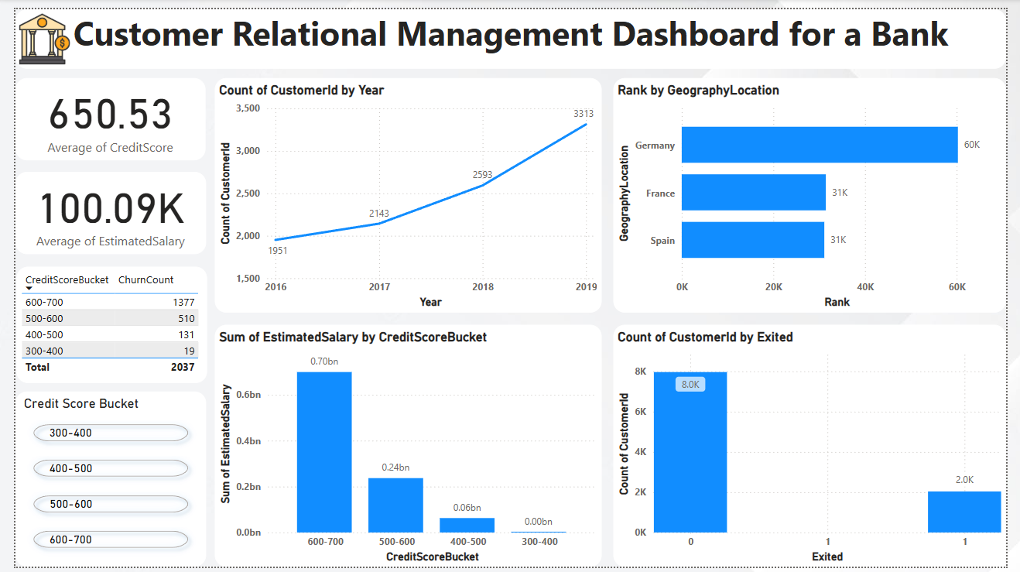
Dashboard 3/3

Slide 20
Thank you

